Slide 1
If you have not already done so, please download the QUartus Prime Lite at: https://www.intel.com/content/www/us/en/software-kit/849770/intel-quartus-prime-lite-edition-design-software-version-24-1-for-windows.html
Go to Learn course page to find this link

Slide 2
VHDL Workshop Introduction

Slide 3
Today’s Teaching Team
Orion Bruckman (EE)
15 years as a lab instructor, 10 years of R&D in computer and consumer electronics fields
Dr. Chris Rennick
Purveyor of all Engineering knowledge
Gabe Ghrayeb
IDEAs Clinic Co-op, 4A Nanotechnology Engineering
Karnan Thamilchelvan
IDEAs Clinic Co-op, 3B Computer Engineering

Slide 4


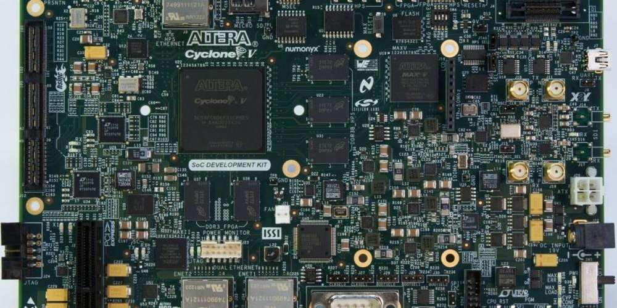
What is an FPGA
Field Programmable Gate Arrays (FPGA) are flexible circuits “chips” that can be configured to act as almost any digital circuit.
These “chips” can be run on a development board as you will be doing today or can be integrated into a larger electronics design.
From: https://ebics.net/cyclone-iv/

Slide 5
Inside an FPGA
Inputs |  |  |  | Output
A | B | C | D | Out
0 | 0 | 0 | 0 | You Decide!!
0 | 0 | 0 | 1
0 | 0 | 1 | 0
0 | 0 | 1 | 1
0 | 1 | 0 | 0
0 | 1 | 0 | 1
0 | 1 | 1 | 0
0 | 1 | 1 | 1
1 | 0 | 0 | 0
1 | 0 | 0 | 1
1 | 0 | 1 | 0
1 | 0 | 1 | 1
1 | 1 | 0 | 0
1 | 1 | 0 | 1
1 | 1 | 1 | 0
1 | 1 | 1 | 1
FPGA can implement almost any circuit by using configurable, interconnecting look-up tables (LUT).
A 4-input look-up table (LUT) is capable of implementing any 4-input logic function with memory to remember the inputs and outputs.
The FPGA family we are using have 25,000 to 301,000 4-input LUTs

Slide 6
Who and Why use and FPGA
Who uses FPGA? R&D engineers
Why use an FPGA? When speed and flexibility are required. FPGAs are faster than software and cheaper, at low and medium volumes, than dedicated “computer chips.”
Examples: specialty circuits and prototyping
Software
Most flexible
Slowest
FPGA
Medium flexible
Medium Speed
Dedicated Circuits
Least flexible
Fastest

Slide 7
How are you going to configure an Fpga
While we often say we “program” and FPGA, actually we configure how an FPGA’s LUTs are connected.
The language we use to configure an FPGA is called a Hardware Description Language (HDL).
The HDL we will be using is VHDL

Slide 8
How to configure an Fpga
Follow along with the instructions to write VHDL code
Remember: VHDL looks a bit like a programing language, it has ‘if’ and ‘case’ statements but the result is not a program. It is an ‘wiring’ of the LUTs
Basic VHDL Structure
You will create an Entity that have Inputs and Outputs
You will define how the Entity behaves by describing its’ Architecture.

Slide 9
There is more to FPGA than this, but you should find this workshop a good introduction.

Slide 10
Questions?

